Slide 1
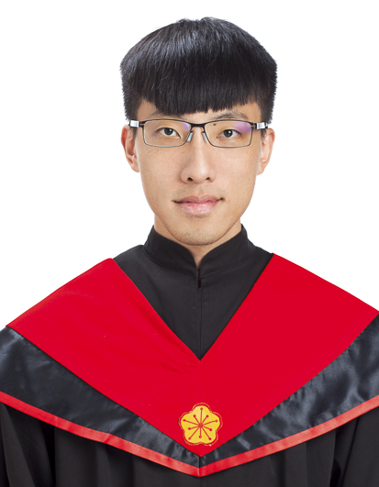
何 奇 軒
About Me
Education
M.S. in Epidemiology and Preventive Medicine, NTU
B.S. in Mathematics, NCKU
Skills
Statistical Data Analysis
Data Visualization
Web Crawler
Machine Learning
Phone: 0921029417
E-mail: jeff665547@gmail.com

Slide 2
Project Experience
Statistical Modeling
Body weight and body fat prediction
Clinical group prediction with gene expression
1
2
Observation measurement
Data management
Variable selection – multicollinearity problem
Model diagnostic
Generalized linear model
SVM with different kernel functions
CART
Cross validation
SVM (sigmoid): 0.95, CART: 0.89
3
Lung cancer survival data prediction comparison
Gene algorithm (GA)
Stepwise selection
GA (0.95) is better than stepwise selection (0.64)

Slide 3
Working Experience
JUL., 2017 Project Assistant
Evaluation and decision for the scopes of questions.
Refined the dialogue data in the shows from TV program.
Dr. Chuhsing Kate Hsiao’s Lab, NTU
1st Formosa Grand Challenge
– Talk to AI, NTU
JUN., 2018 Research Assistant
Master’s Thesis.
The multivariate normality of the real data. (Distance-based methods)
Simulation data construction with the mixture distributions.
Evaluation of gene-set analysis methods. (Distance-based, Regression-based)
Interactive plots package,“plotly”.
Radar plots and grouped dot plots development.

Slide 4
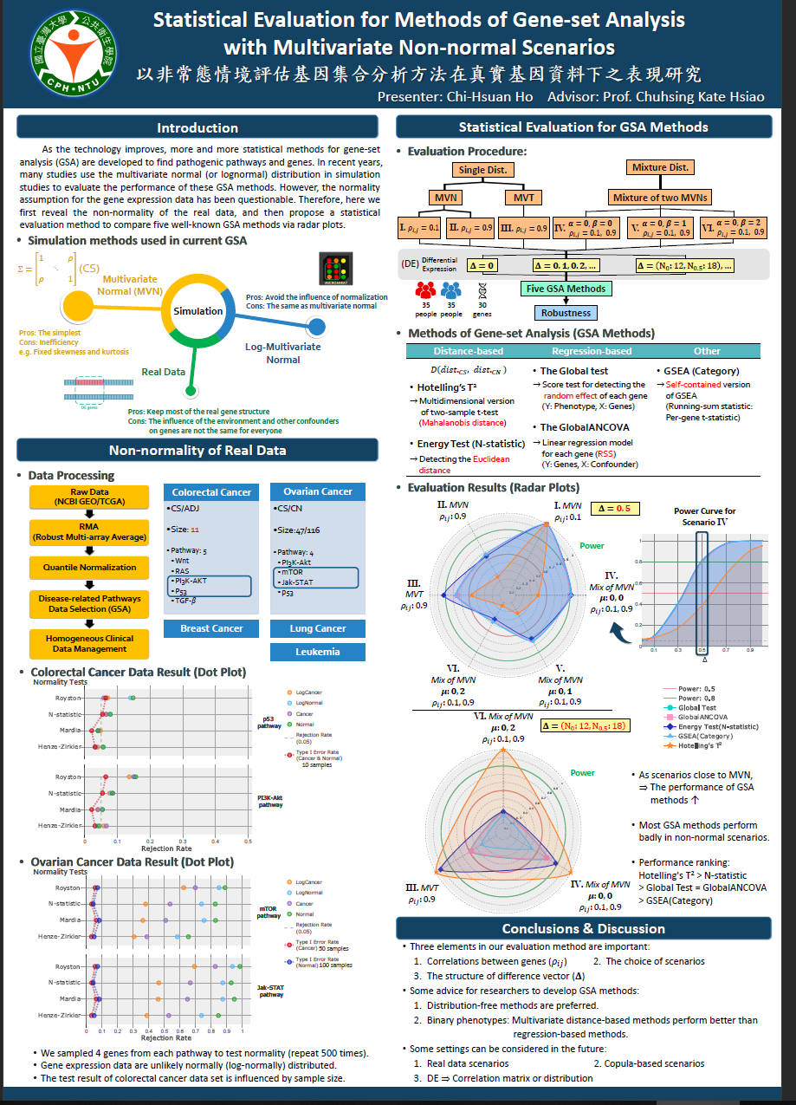
Awards and Club Activities
Awards
The first place (43 participants) at master’s thesis poster exhibition, 2018.
The third place (425 participants) in the 2015 statistical competition in NCKU.
Club Activities
Activities department, the fifth and six math camp, NCKU.
Administration department, student association of mathematics, NCKU.

Slide 5
Self-learning and Career Plan
Machine Learning
Programming
Senior Data Scientist
Algorithm
C, C++
English
Deep Learning
Certifications
Information System Training Program of CSIE, NTU
Python
Linux
MySQL

Slide 6
THANK YOU

Slide 7
Appendix

Slide 8

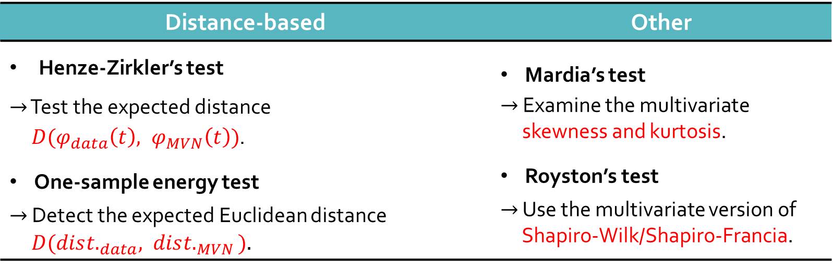
The Non-normality of Real Data
The normality test
$H_{0}:$Data are normally distributed.
Problem: Singular matrix ($p$ > $n$)
$⇒$ Sample 4 genes from each pathway to test (repeat 500 times)
Distance-based | Other
Henze-Zirkler’s test $→$ Test the expected distance $D(φ_{data}\left(t\right), φ_{MVN}\left(t\right))$. One-sample energy test $→$ Detect the expected Euclidean distance $D(dis{t.}_{data}, dis{t.}_{MVN})$. | Mardia’s test $→$ Examine the multivariate skewness and kurtosis. Royston’s test $→$ Use the multivariate version of Shapiro-Wilk/Shapiro-Francia.

Slide 9
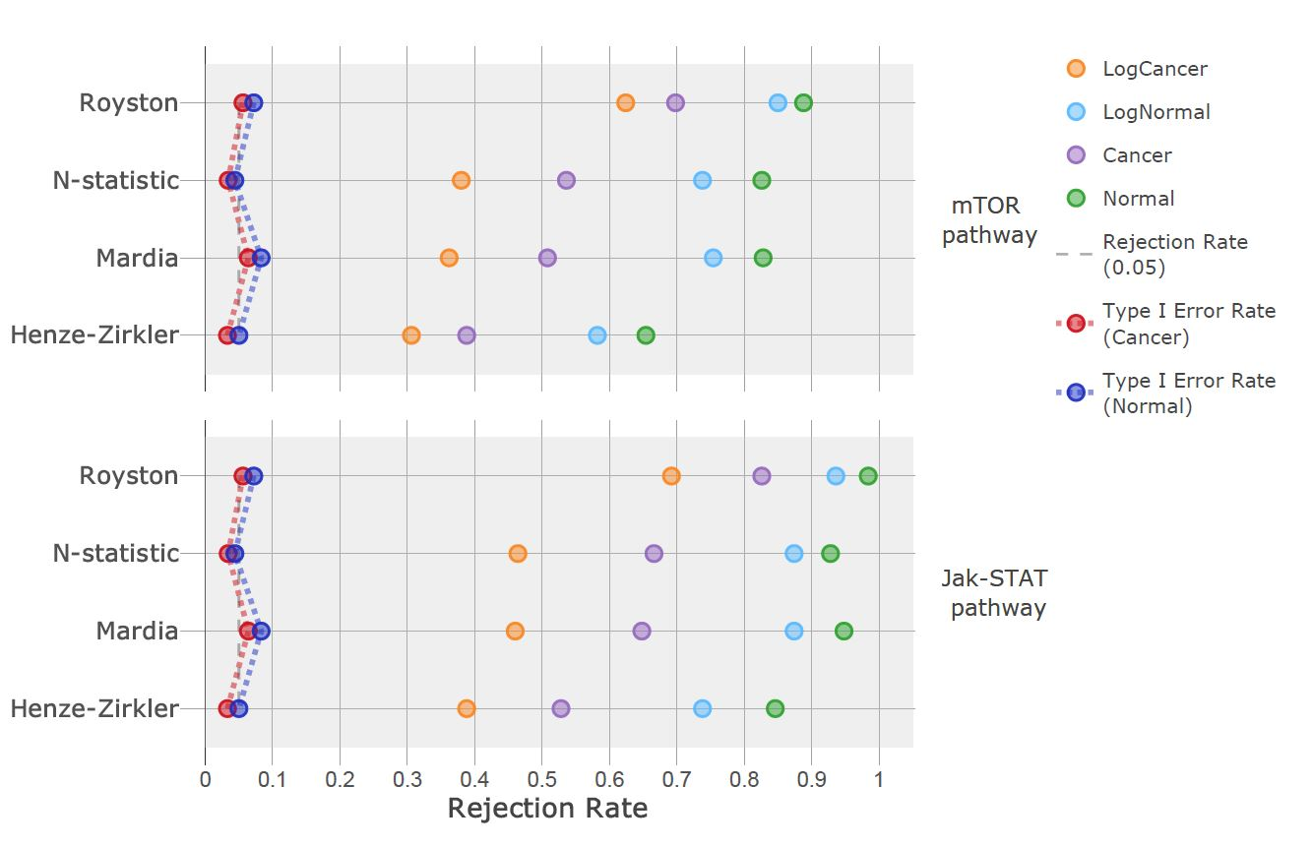
The Non-normality of Real Data
Ovarian cancer data result
CS: 47, CN: 116
is based on 50 samples.
is based on 100 samples.
Data is not normally (log-normally)
distributed.

Slide 10
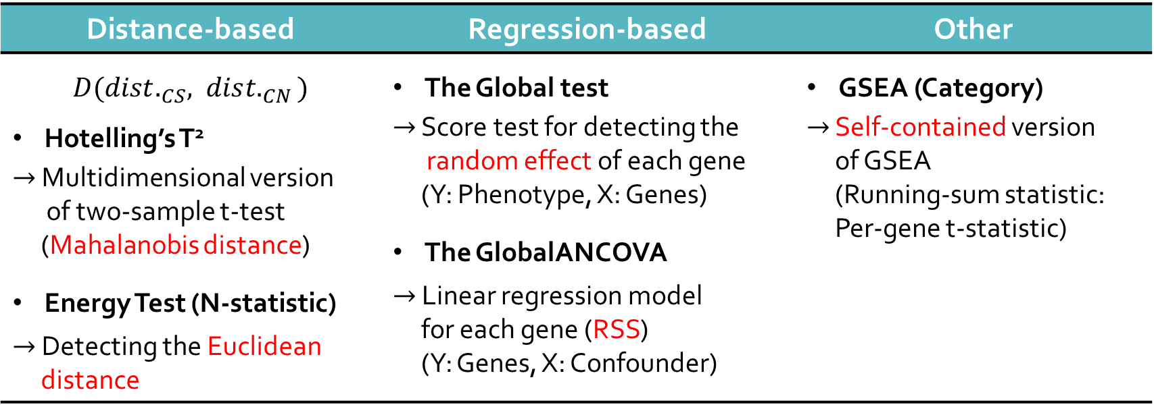

A Statistical Evaluation for GSA Methods
GSA methods:
$H_{0}：$No difference between the distributions/mean vector of the two phenotypes.
p-value: 1000 permutations
Distance-based | Regression-based | Other
$D({dist.}_{CS}, dis{t.}_{CN})$ Hotelling’s T² $→$ Multidimensional version of two-sample t-test (Mahalanobis distance) Energy Test (N-statistic) $→$ Detecting the Euclidean distance | The Global test $→$ Score test for detecting the random effect of each gene (Y: Phenotype, X: Genes) The GlobalANCOVA $→$ Linear regression model for each gene (RSS) (Y: Genes, X: Confounder) | GSEA (Category) $→$ Self-contained version of GSEA (Running-sum statistic: Per-gene t-statistic)

Slide 11
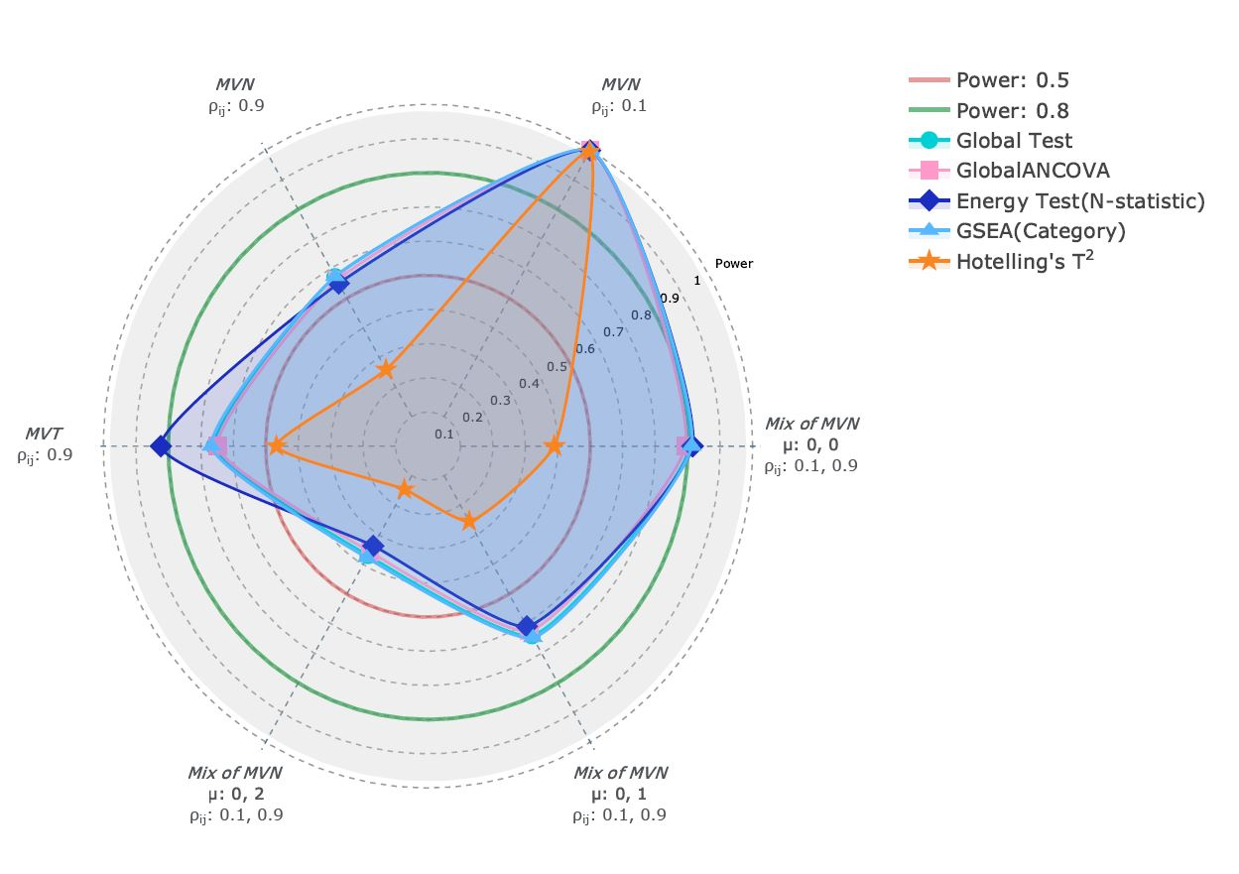


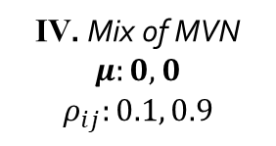

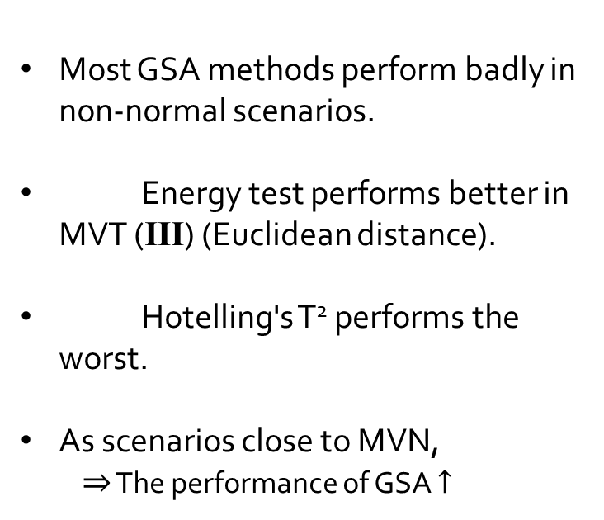

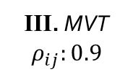
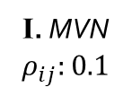

Power Performance
Most GSA methods perform badly in non-normal scenarios.
Energy test performs better in MVT (III) (Euclidean distance).
Hotelling's T² performs the worst.
As scenarios close to MVN,
$⇒$ The performance of GSA $↑$
II. MVN
$$ρ_{ij}:0.9$$
I. MVN
$$ρ_{ij}:0.1$$
Power
III. MVT
$$ρ_{ij}:0.9$$
IV. Mix of MVN
$$μ:0, 0$$
$$ρ_{ij}:0.1, 0.9$$
VI. Mix of MVN
$$μ:0, 2$$
$$ρ_{ij}:0.1, 0.9$$
V. Mix of MVN
$$μ:0, 1$$
$$ρ_{ij}:0.1, 0.9$$

Slide 12
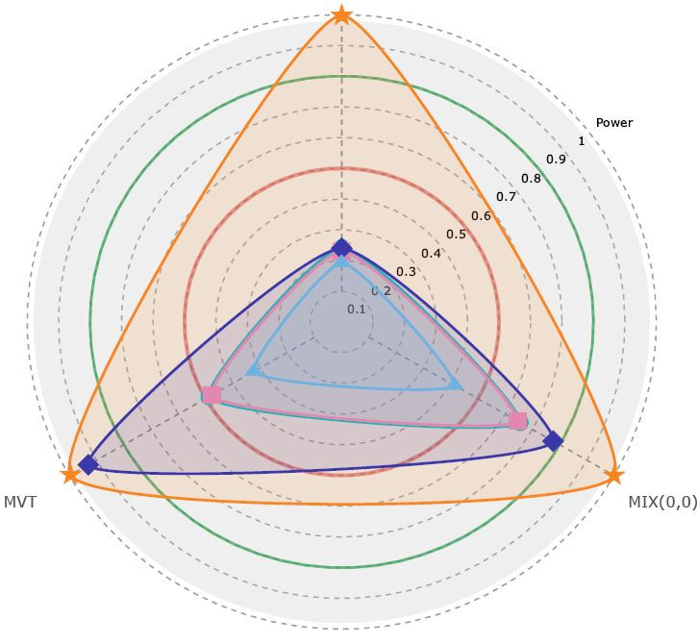

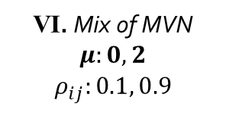
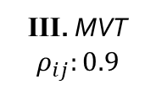
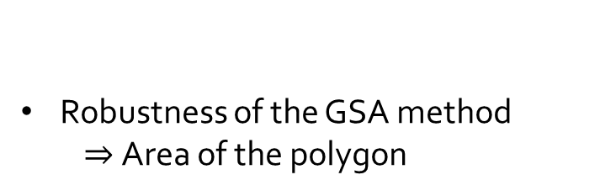


Power Performance
VI. Mix of MVN
$$μ:0, 2$$
$$ρ_{ij}:0.1, 0.9$$
$$Δ=\left(N_{0}:12, N_{0.5}:18\right),…$$
Mean of elements in 𝚫: 0.3 Variance of elements in 𝚫: 0.0621
Axis: Scenario (III, IV, VI)
Hotelling's T² is dominating under this difference vector structure (Mahalanobis distance).
Power
III. MVT
$$ρ_{ij}:0.9$$
IV. Mix of MVN
$$μ:0, 0$$
$$ρ_{ij}:0.1, 0.9$$
Robustness of the GSA method
$⇒$Area of the polygon

Slide 13
The Non-normality of Real Data
Data processing
Breast
Colorectal
Quantile Normalization
Raw Data (NCBI GEO/TCGA)
RMA (Robust Multi-array Average)
Disease-related Pathways Data Selection (GSA)
Homogeneous Clinical Data Management
Lung A
Lung B
Leukemia
Ovarian
CS/ADJ
Size: 13
Pathway: 2
PI3K-AKT
Wnt
CS/ADJ
Size: 11
Pathway: 5
Wnt
RAS
PI3K-AKT
P53
TGF-$β$
CS/ADJ
Size: 21
Pathway: 7
MAPK
Wnt
Cell cycle
mTOR
P53
EGFR
JAK-STAT
CS/ADJ
Size: 47
Pathway: 7
MAPK
Wnt
Cell cycle
mTOR
P53
EGFR
JAK-STAT
CS/CN
Size: 19/10
Pathway: 4
PI3K-Akt
mTOR
JAK-STAT
Wnt signaling
CS/CN
Size:47/116
Pathway: 4
PI3K-Akt
mTOR
Jak-STAT
p53

